Slide 1
EXTINGUISHMENT AND DIVERSION OF HIGHWAYS
Ruth Stockley
Barrister

Slide 2
Why?
Disuse
No longer necessary
Development needs and requirements
Landowner requirements – e.g. privacy and peace and quiet
NO CONCEPT OF ABANDONMENT OF A HIGHWAY

Slide 3
Necessity of Stopping Up Order
Will a TRO suffice?
Highway would continue to exist.
Must be made for a traffic reason.
Other statutory requirements in Road Traffic Regulation Act 1984 must be met.
Temporary TRO’s under s.14 can be useful.

Slide 4
Choosing the appropriate power
S116 Highways Act: Stopping Up or Diversion
S118/119 Highways Act
Public Path Extinguishment and Diversion
Section 247/257 Town and Country Planning Act: To enable development to be carried out

Slide 5
S116 Stopping Up or Diversion
Stopping Up:
Highway “unnecessary”
Diversion:
“Nearer or more commodious to the public”

Slide 6
Pros and Cons
 | X
Speed in uncontroversial cases: Application to Magistrates | Strict statutory tests Merits of any development not relevant to decision
No compensation payable | Strict Procedural Requirements
Costs can be met by person seeking order: s.117 | District and Parish Council: Power of Veto
 | Public opposition Unpredictable magistrates Right of Appeal to Crown Court

Slide 7
S116 Stopping up Test of necessity
Evidence might include:
Evidence of lack of Public use
Evidence of an alternative route

Slide 8
S116 Diversion Test: Nearer or more commodious
Quality of the highway
Types of highway user
Places served by highway
Diversion must give public same rights to pass and re pass

Slide 9
S118 – 119: Public Path Extinguishment and Diversion Orders: Pros and Cons
 | X
OMA can make a charge for costs incurred in making Order and notification | Potentially lengthy procedure. Extensive notification and potentially public inquiry. Additional notification and procedure where modifications made
No right of veto by District or Parish Council | Complex statutory requirements
 | Compensation payable where interests adversely affected.

Slide 10
Hurdles: S118: Extinguishment
(1) OMA: “Appears” expedient on ground not needed for public use
(2) Confirming Authority:
“Satisfied” expedient, having regard to
Extent path likely to be used apart from Order
Likely effect on land served by path

Slide 11
Hurdles: S119 Diversion
OMA
“Appears” expedient either:
i. In the interests of the owner, lessee or occupier of land crossed by the path, or
(ii) In the interests of the public.
(2) Confirming Authority
“Satisfied”
Expedient
Not substantially less convenient
Expedient having regard to the effect on:
Public enjoyment path or way as a whole
Coming into operation of the Order would have on other land served by PROW
Effect of new PROW.

Slide 12
Temporary Obstructions disregarded

Slide 13
S247/S257 Town and Country Planning Act
2 Preconditions:
(i) That there is a conflict between the development authorised by a planning permission and the continued existence along its present line of the highway, and
(ii) That the extinguishment or diversion must enable development to be carried out.

Slide 14
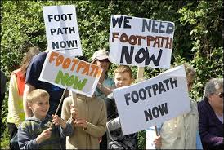
Balance for the decision maker but…
X
Planning merits not reopened. Merits of development are presumed and taken into account
Highway Impacts are determined and taken into account

Slide 15
TCPA Pros and Cons:
 | X
OMA can make a charge for costs incurred in making Order and notification | Potentially lengthy procedure. Extensive notification and potentially public inquiry. Additional notification where modifications made
No right of veto by District or Parish Council
Wider balance, including planning benefits, taken into account
Can make application prior to grant of planning permission so it can be progressed concurrently with application for planning permission No compensation payable

Slide 16
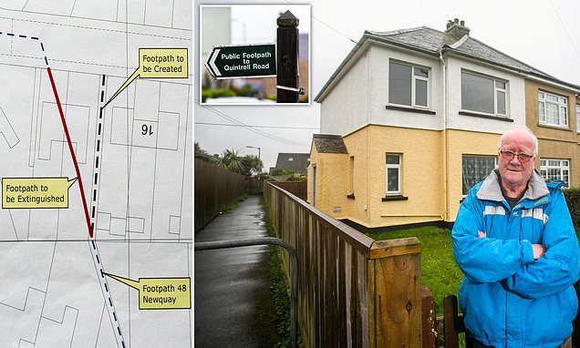
Timing is critical: Only available for development “to be carried out”
“Right of way right through OUR house”

Slide 17
Refusal to make Order
If local highway authority refuse to make a s.116 application, or if local authority or local planning authority refuse to do make an Order under ss.118/119 HA or under ss.247/257 TCPA upon an application by a third party, only available remedy is judicial review.

Slide 18
Section 258 Orders
S.258(1):-
“Where any land has been acquired or appropriated for planning purposes and is for the time being held by a local authority for the purposes for which it was acquired or appropriated, then, subject to section 259, the local authority may by order extinguish any public right of way over the land, being a footpath, bridleway or restricted byway, if they are satisfied—
(a) that an alternative right of way has been or will be provided; or
(b) that the provision of an alternative right of way is not required.”

Slide 19
Section 258 Orders
A similar power is provided to the Secretary of State in s.251, including for vehicular highways.
Both ss.251 and 258 provide a simple and expeditious method of closing public highways on land acquired under the provisions contained in Part IX of the TCPA or which has been appropriated for purposes for which land can be acquired under those provisions.
Part IX is concerned with the acquisition and appropriation of land for planning purposes.

Slide 20
Section 258 Orders
An Order may only be made under ss.251 or 258 where the decision maker is satisfied either that an alternative right of way has been, or will be, provided or that the provision of an alternative right of way is not required.
The power is to stop up the highway and not to divert it.

Slide 21
Effects of Stopping Up Orders
Highway ceases to exist.
If highway was maintainable at public expense, ownership of its surface that was vested in local highway authority will revert to owner of sub-soil.
Stopping up orders only affect public rights of way and will not remove any private rights of way.

Slide 22
Effects of Stopping Up Orders
Rights of way stopped up should be deleted from Definitive Map and Statement.
S.53A Wildlife and Countryside Act 1981 enables administrative orders made under s.257 TCPA to contain express provision for Definitive Map and Statement to be modified accordingly without a separate Modification Order under the 1981 Act being necessary.

Slide 23
^{ANY QUESTIONS?}

