Slide 1
THE PHYSICAL EXTENT OF A HIGHWAY
By Ruth Stockley
Barrister

Slide 2
Where is Highway Boundary?

Slide 3
Where is Highway Boundary?

Slide 4
Where is Highway Boundary?

Slide 5
Hedge to Hedge Presumption
^{Not a legal presumption.}
Useful rule of thumb where most obvious explanation for existence of the hedge or fence is to separate adjoining land and where no other explanation for position of hedge or fence is forthcoming.

Slide 6
Hedge to Hedge Presumption
Hale v Norfolk County Council [2001] Ch 717
“. . . the presumption of dedication of all the land running between hedges or fences can only arise if there is reason to suppose that the hedge or fence was erected by reference to the highway: that is, to separate the land over which there was to be no public right of way from the land over which there was to be such a right. Where matters are lost in the mists of time, it must often be possible to draw such an inference from the layout on the ground. In a conventional road running between hedges or fences, even if the verges are of varying widths and shapes, this may well be the obvious conclusion.”

Slide 7
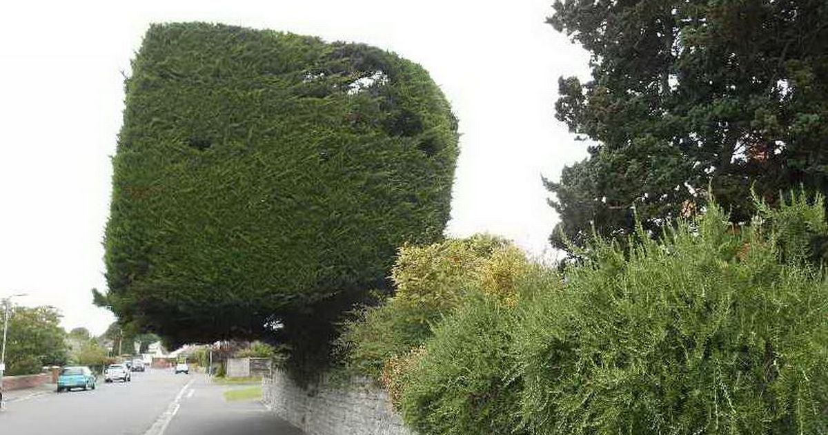
Hedge to Hedge Presumption

Slide 8
Ditches
In general the public won’t ever have been able to pass or re-pass over the line of a ditch.
^{Question of evidence.}
Conventional view is edge of highway is likely to be on highway side of a ditch unless there is evidence it was constructed by a highway authority.

Slide 9
Importance of Function of Ditch
Highway authorities have had power to construct ditches to drain highways since 1835 and if a ditch drains a highway it may be regarded as being part of that highway.
However, be aware of powers of highway authorities to construct and use drains and ditches outside highway: s.100 Highways Act.

Slide 10
Presumptions do not always apply
Where a highway specifically constructed, width will often be apparent from relevant instrument.
^{Examples:}
^{Inclosure Awards.}
^{Turnpike Acts.}
^{Compulsory Purchase Orders.}
^{Section 38 Agreements.}

Slide 11
Verges
Verges within old highways will be probably be within the “hedge to hedge” width of highway.
Maintenance history may be helpful, but unlikely to throw much light on status of verge.
Presence of street furniture or statutory undertakers’ apparatus may be indicative of a long standing belief that verge is part of highway.

Slide 12
Practical Considerations
An accurate survey of the highway, any hedge or ditch, and adjoining land is important.
Old maps should be considered, especially those of a larger scale; and
When dealing with old highways, especially BOATs and Restricted Byways, it is useful to check whether laid out under an Inclosure Award.

Slide 13
Practical Considerations
^{BUT NOTE:}
O.S. Maps are not evidence of highway status.
Maps cannot identify width of highway, but can indicate whether bounded by a physical feature.
^{Margins of error!}

Slide 14
Highway and Highway Land
Not all land acquired for highway construction or improvement is actually used to construct highway.
E.g. s.246(1) Highways Act permits acquisition of land for:
“the purpose of mitigating any adverse effect which the existence or use of a highway constructed or improved by them, or proposed to be constructed or improved by them, has or will have on the surroundings of the highway”.
Beware the expression “highway land”!

Slide 15
Highway Structures
Embankments, Cuttings and Retaining Walls.
General Principle: Anything constructed to support the highway, such as an embankment, will be part of highway.

Slide 16
Highway Structures
^{Crucial Factors:}
When was structure constructed?
^{By whom was it constructed?}
^{For what purpose?}

Slide 17
Depth of Highway
Non-Maintainable Highways: Depth is limited to surface of highway.
Maintainable Highways: S.263 HA vests highway in highway authority.

Slide 18
Depth of Highway
Tithe Redemption Commissioners v Runcorn UDC [1954] 1 Ch. 383
^{Per Denning L.J.:}
“The statute of 1929 vested in the local authority the top spit, or, perhaps, I should say, the top two spits, of the road for a legal estate in fee simple determinable in the event of its ceasing to be a public highway.”

Slide 19
Depth of Highway
London Borough of Southwark v. Transport for London
^{[2018] 3 W.L.R. 2059}
^{Per Lord Briggs:}
“That slice of the vertical plane included, of course, the surface of the road over which the public had highway rights, the subsoil immediately beneath it, to a depth sufficient to provide for its support and drainage, and a modest slice of the airspace above it sufficient to enable the public to use and enjoy it, and the responsible authority to maintain and repair it, and to supervise its safe operation”.

Slide 20
Depth of Highway
London Borough of Southwark v. Transport for London
^{[2018] 3 W.L.R. 2059}
^{Per Lord Briggs:}
“It is common ground that the zone of ordinary use is a flexible concept, the application of which may lead to different depths of subsoil and heights of airspace being vested in a highway authority, both as between different highways and even, over time, as affects a particular highway, according to differences or changes in the nature and intensity of its public use.”

Slide 21
Ownership of Highway
Non-Maintainable Highways: Ownership of surface and subsoil remains with dedicating landowner.
Maintainable Highways: Surface & Zone of Ordinary Use (Top 2 Spits) owned by highway authority; subsoil remains with dedicating landowner.

Slide 22
Ownership of Highway
Established common law principle: Existence of a highway does not destroy landowner’s interest in land over which it passes.
Landowner who dedicates a highway over his land gives to public only a right of passage over land and retains all other rights of ownership which are not inconsistent with right of passage.

Slide 23
Ownership of Highway
For new highways constructed by a local highway authority, they will often have acquired whole of land on which highway is to be constructed or improved by agreement or by compulsory purchase.
But for highways which have grown up over time, ownership remains with the dedicating landowner.

Slide 24
Ad Medium Filum Presumption
General common law presumption: Owner of land adjoining a highway is presumed to be owner of the soil of one-half of the highway, namely up to the middle line – usque ad medium filum viae.
Effect of presumption is that boundary of a piece of land that abuts a highway extends “ad medium filum” (to the medium line) of the highway which is co-extensive with that land.

Slide 25
Ad Medium Filum Presumption
Presumption sometimes regarded as an arbitrary rule of convenience adopted as the fairest mode of solving difficulties given that the title must be in someone, but that actual knowledge of ownership may no longer exist.
Also been suggested that it is based on a presumption that adjoining owners each contributed half of the land required for a new highway: see Doe d Pring v Pearsey (1827) 7 B & C 304 per Bayley J.

Slide 26
Ad Medium Filum Presumption
If the road is a highway maintainable at public expense, the ad medium filum presumption applies only to the subsoil which is not vested in the local highway authority.
Presumption of law.
Capable of rebuttal by evidence of ownership of soil.

Slide 27
^{Any Questions}

